Slide 1


ML.NET
Professor: Dr.RAJAEI
Hediye Jamili
June 2023

Slide 2

What is Machine Learning?
“The goal of machine learning is
to program computers
to use example data or past experience
to solve a given problem.”
2

Slide 3





What it is?
An open source and cross-platform machine learning framework
Built for .NET
C# developers
Custom ML made
easy with tools
F#
Extended with
TensorFlow & more
Trusted &
proven at scale
3

Slide 4


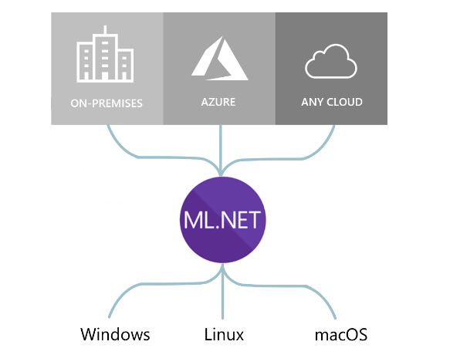
ML.NET runs anywhere
4

Slide 5


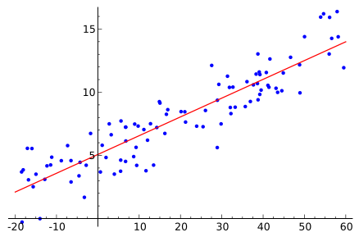
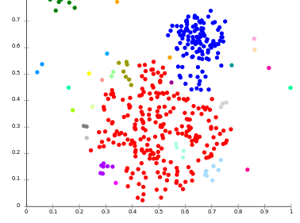
Different ML scenarios
Classification Regression Clustering Recommendation
5

Slide 6







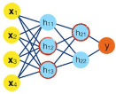






Machine Learning workflow
Datasets
ML model _{ML model}
Prepare Your Data Build & Train ^{Run}
Model creation
Model consumption
6

Slide 7
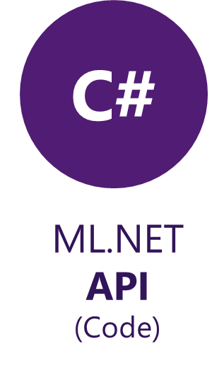
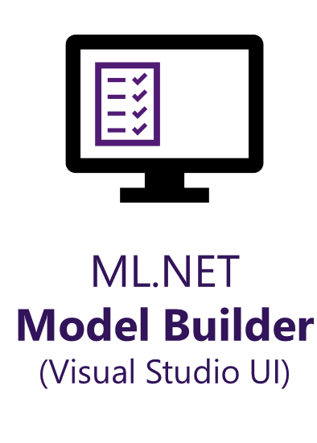
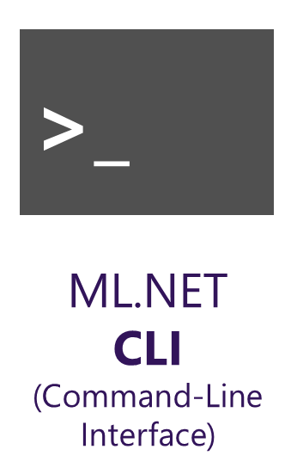
Three ways to use ML.NET
7

Slide 8

Model Builder demo
ML.NET Model Builder is an intuitive graphical Visual Studio extension to build, train, and deploy custom machine learning models.
Model Builder uses automated machine learning (AutoML) to explore different machine learning algorithms and settings to help you find the one that best suits your scenario.
You don't need machine learning expertise to use Model Builder. All you need is some data, and a problem to solve. Model Builder generates the code to add the model to your .NET application.
8

Slide 9
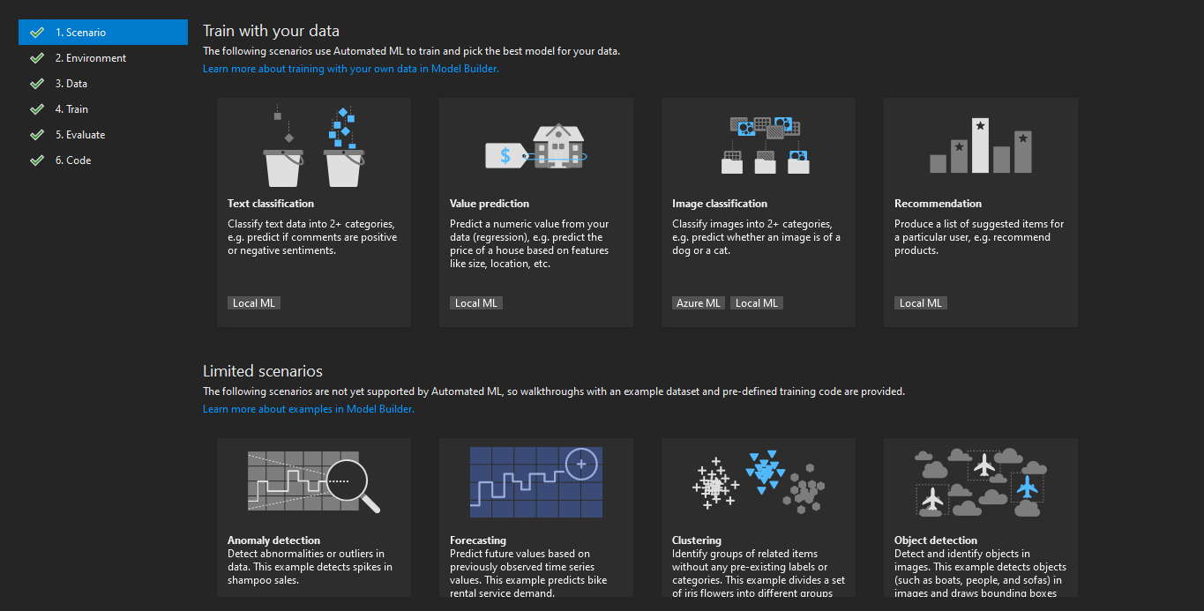
Model Builder
UI in Visual Studio that uses AutoML
9

Slide 10
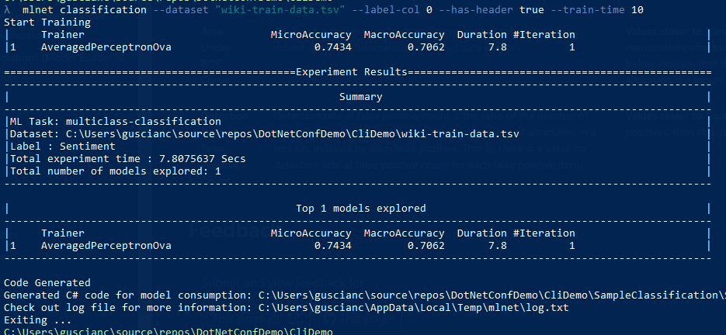
ML CLI demo
10

Slide 11
Questions ?
11

Slide 12


source
https://learn.microsoft.com/en-us/dotnet/machine-learning/
https://code-maze.com/csharp-mlnet-machine-learning-introduction/
https://learn.microsoft.com/en-us/dotnet/machine-learning/tutorials/predict-prices
https://github.com/dotnet/machinelearning-samples/blob/main/README.md?WT.mc_id=dotnet-35129-website
https://archive.ics.uci.edu/datasets?skip=0&take=10&sort=desc&orderBy=NumHits&search=
12

Slide 13
Thank you!
13

